Slide 1

Pick & Place Industrial Robot
Team 6
By: Teodore Maged - Mazen Mostafa - Kareem Mohamed - Sara Wasfy - Mayar Bahnacy - Ahmed Hemeida

Slide 2
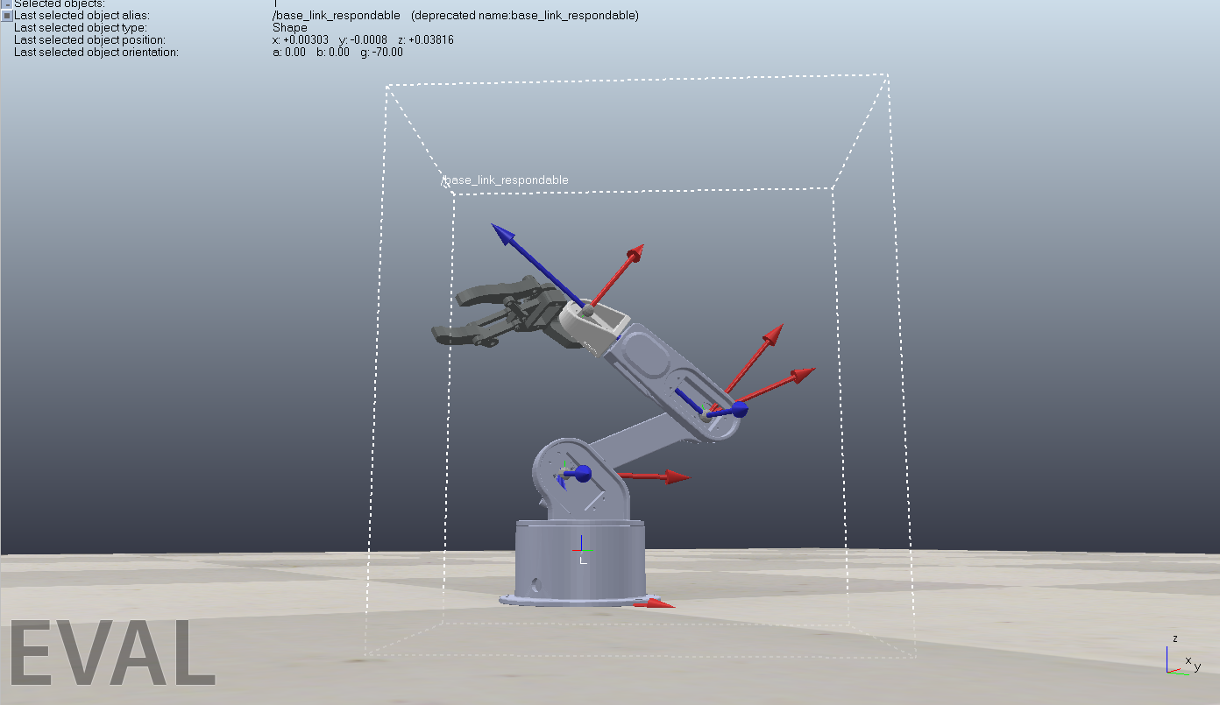
Milestone 1
Conducted a literature review where each team member summarized 2 papers and the whole team integrated them together; thus reaching the draft project flow.
After a brainstorming session, we decided to choose the pick & place industrial robot.
Teodore searched for grabCAD models of the robot.
All the team members installed CoppeliaSim and set up the robot.

Slide 3
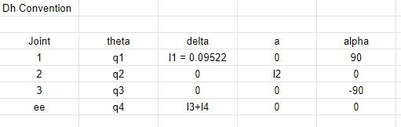
DH Convention
Kareem assigned the coordinate frames to the robotic arm joints and base in CoppeliaSim.
Sara & Mazen developed the DH parameters to define the kinematics of the robot.
Teodore & Kareem tested the DH parameters to obtain the forward position kinematics
Mayar set up the GIU of the industrial environment
Ahmed wrote the report for the milestone.

Slide 4
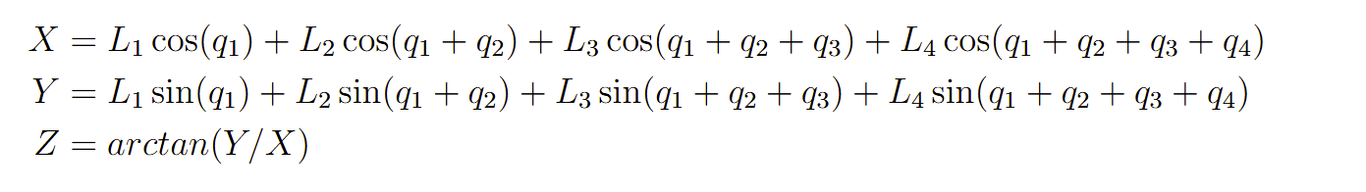
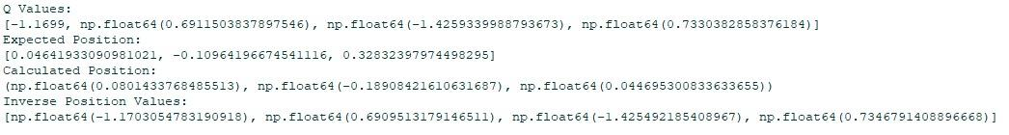
Forward & Inverse Position Kinematics
Teodore & Kareem fixed the DH parameters after the evaluation.
Sara & Mazen derived the inverse position kinematics for the robot.

Slide 5
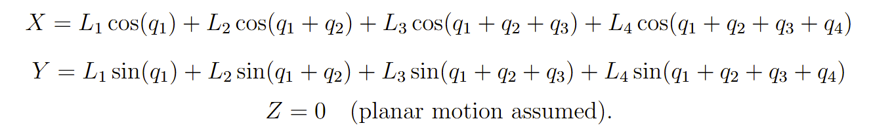
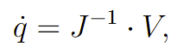
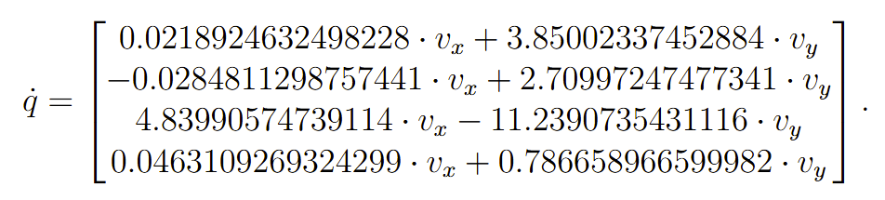
Forward & Inverse Velocity Kinematics
Teodore & Mayar derived the forward & inverse velocity kinematics for the robot.
Teodore & Ahmed validated the equations for the position & velocity kinematics.
Ahmed wrote the report for the milestone.

Slide 6
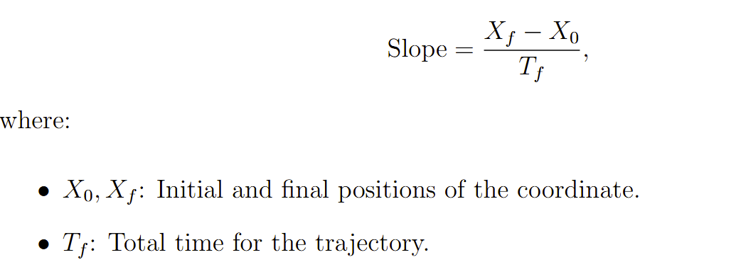
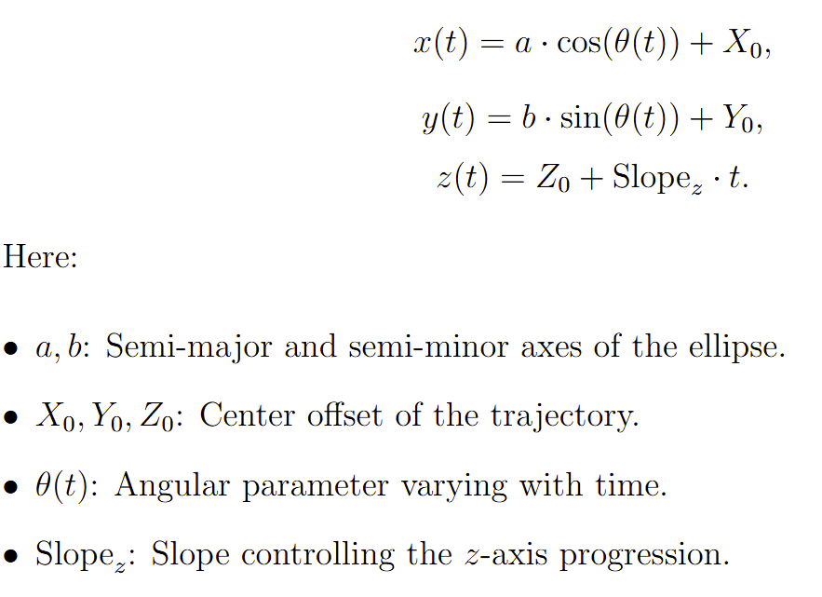
Trajectory Planning
Kareem & Mazen implemented the first task space trajectory (linear)
Sara & Ahmed implemented the second task space trajectory (elliptical)
Teodore & Mayar validated the trajectories created and tested them based on the limitations of the robot.
Sara & Ahmed & Mazen finalised the report.

Slide 7
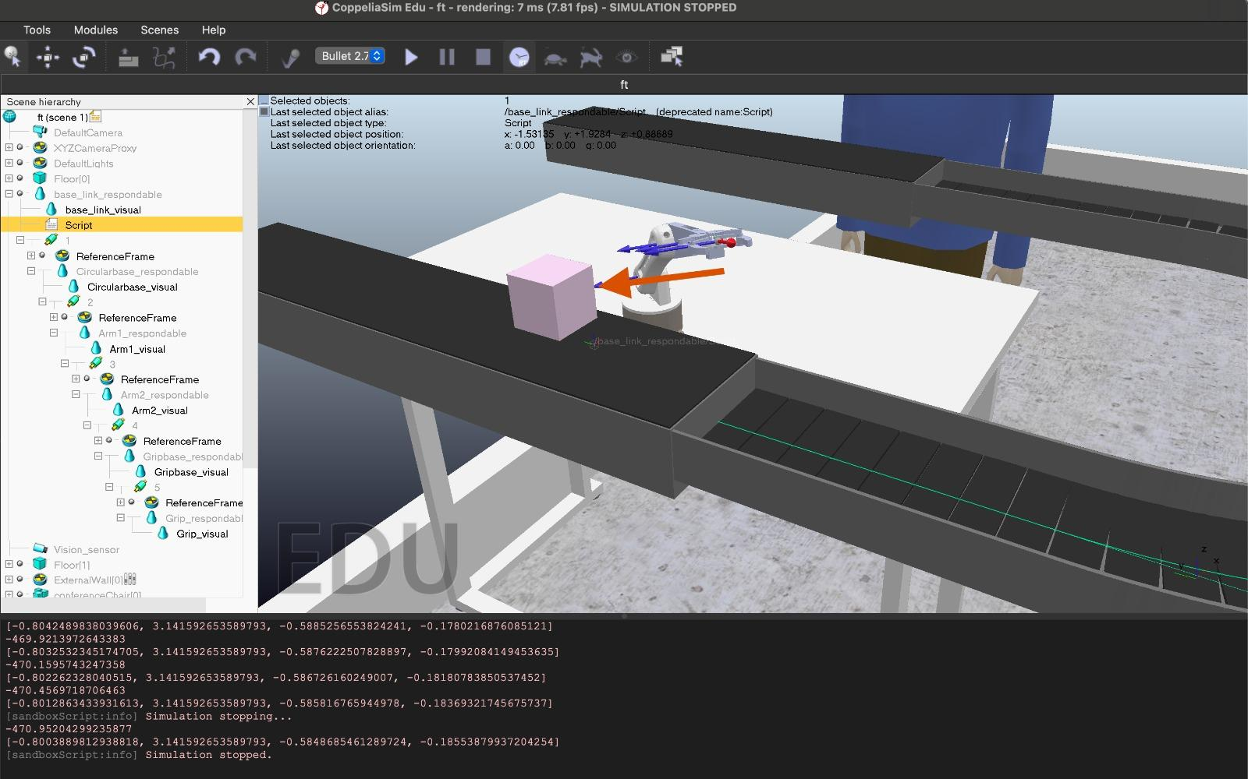
Milestone 5
Ahmed & Sara created the presentation slides.
Kareem & Mazen & Teodore developed the task space trajectory (linear)
Sara & Mayar tested the trajectories to validate the industrial application selected.
Ahmed & Mazen & Mayar wrote the new final report using the latex template.

Slide 8


